Slide 1
Overview of Modeling and Process Monitoring for Additive Manufacturing at MOEMS Laboratory
Distinguished Professor
Yu-Lung Lo 羅裕龍
National Cheng Kung University
Department of Mechanical Engineering
Micro-opto Electronics Sensors Laboratory

Slide 2
OUTLINE
Overview of Research Direction in 3D SLM Lab.
Our Methodology and What We’ve Done for
SLM/DED/EBM in modeling and monitoring
3. Novelties and Research Results

Slide 3
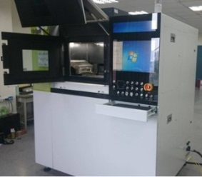
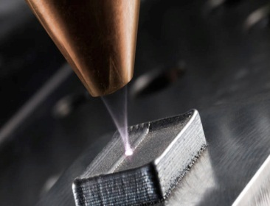
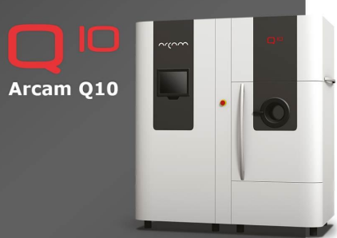
Challenges in Additive Manufacturing
SLM
Electron Beam Acceleration Voltage
Simulation model
How can we make this idea become reality !
Beam Size
Laser power
10-400 W
DED
Data Mining for Surrogates Modeling
Lots of experiment for searching suitable parameters
Identify Optimal Parameters
Scanning speed
10 – 2000 mm/s
Powder size distributions
EBM
Monitoring system
Expensive and time consuming
Number of experiment can be greatly reduced
New powder material
Powder Flow Rate

Slide 4
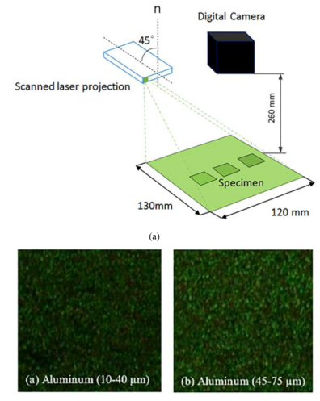
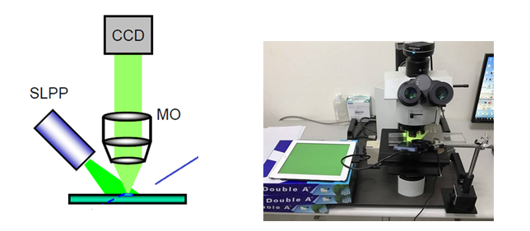
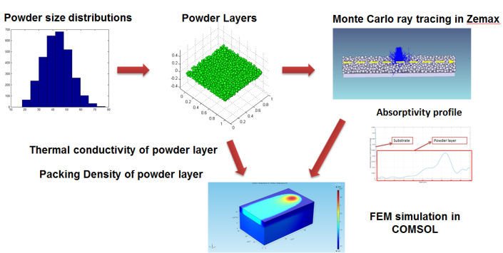
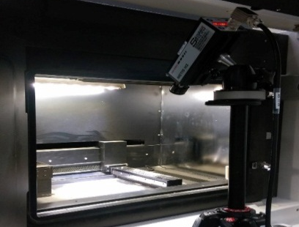
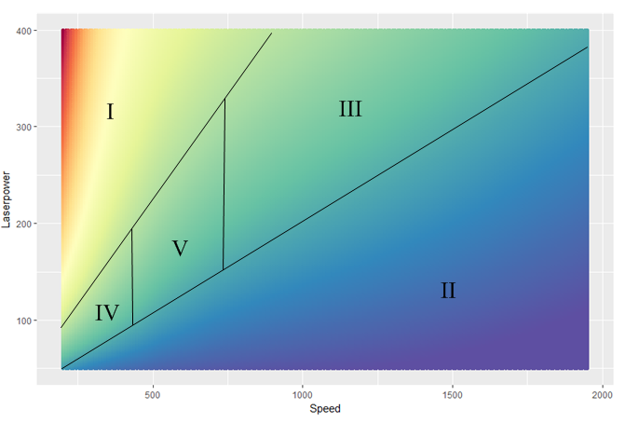
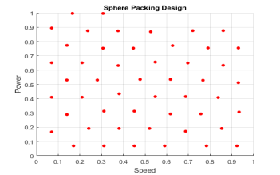
Our Methodology in SLM system
Scattering Effects of Powder Layer With Different Size Distributions
SLM
In-House Device for Quantify Surface Roughness of Single Scan Track
Material :
SS316L
Mg and Mg Alloy
Ti6Al4V, Nickel 718 Alloy
Temperature Measurement System
Surrogates Modeling for ultrafast prediction
Simulation Model

Slide 5
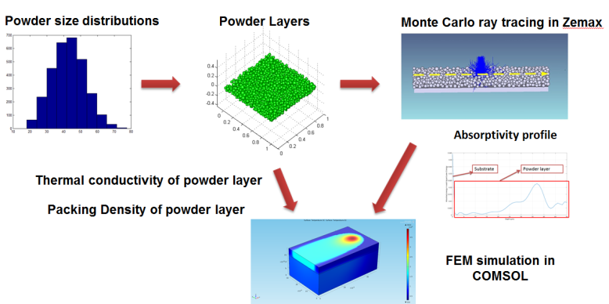
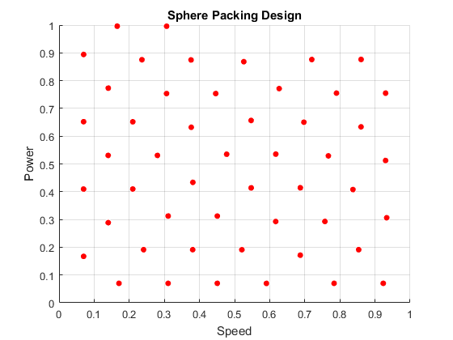
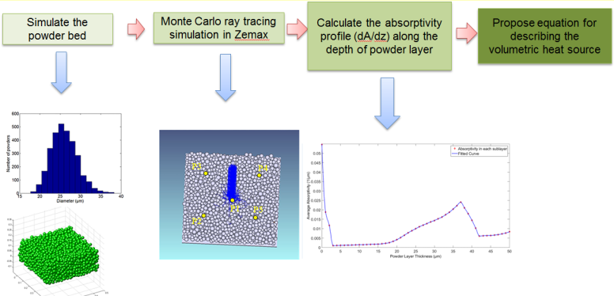
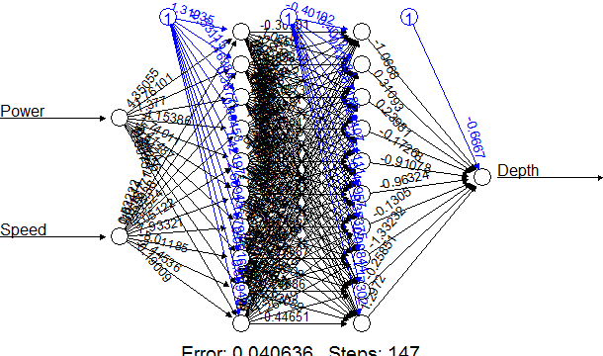
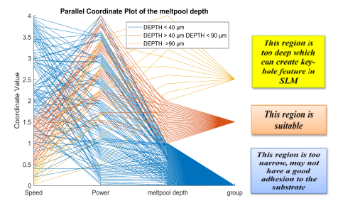
FEM and Surrogates Modeling for SS316L
We built up FEM simulation and Surrogates Modeling to ultrafast generating processing maps for SLM process using SS316L
10000 Data Points for 1 minutes in normal laptop

Slide 6
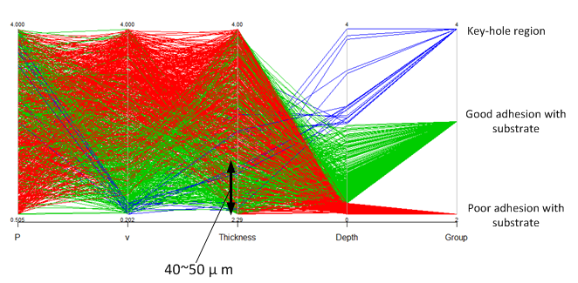
Processing Map for SS316L
Effect of Laser Power, Scanning speed, Layer thickness on formation of melt pool
From simulation and data mining, we confirm that layer thickness in manufacturing process should equal to 40~50 µm.

Slide 7
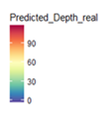
Processing Map for SS316L
Melt pool in this region is too deep ( > 60 µm)
Key-hole model melting
Lowering the density of parts

Slide 8
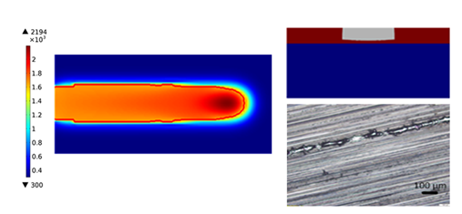
Processing Map for SS316L
Region that has poor adhesion with the substrate
P = 200W ; v = 1500 mm/s

Slide 9
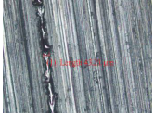
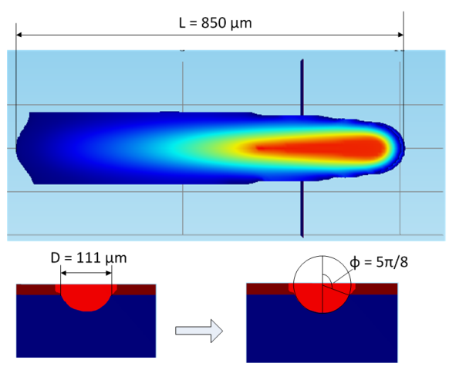
Processing Map for SS316L
The geometry of melt pool can not meet Rayleigh capillary stable condition (Yadroitsev et al., 2010)

Slide 10
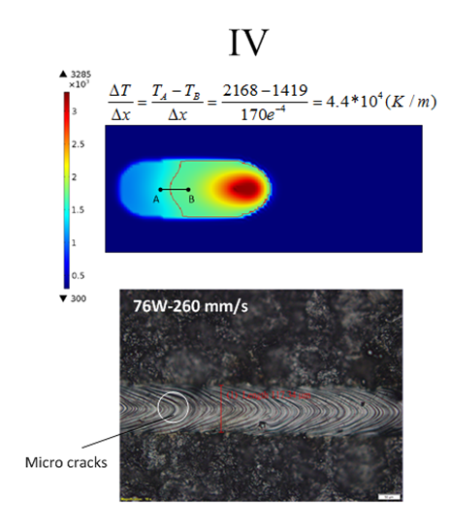
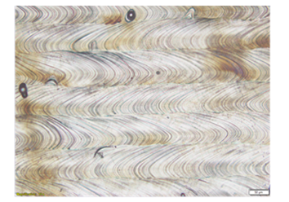
Processing Map for SS316L
(high thermal gradient region)
=> micro cracks
=> High surface roughness

Slide 11
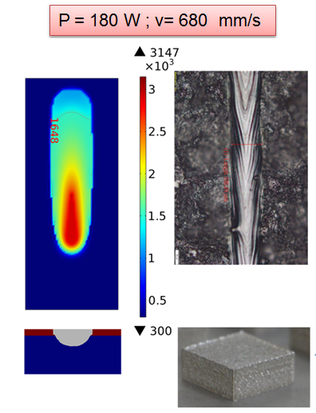
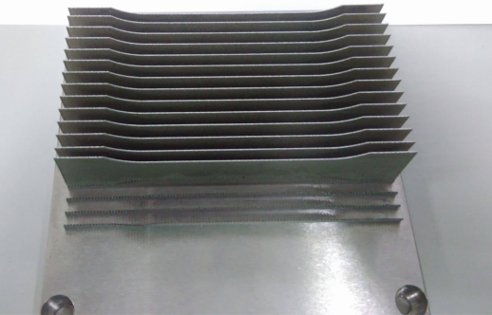
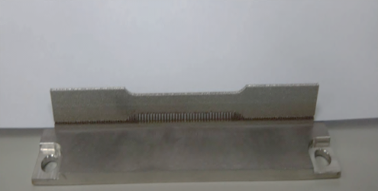
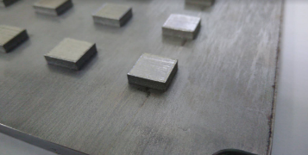
Processing Map for SS316L
Cross section of sample
Density = 99, 97 %

Slide 12
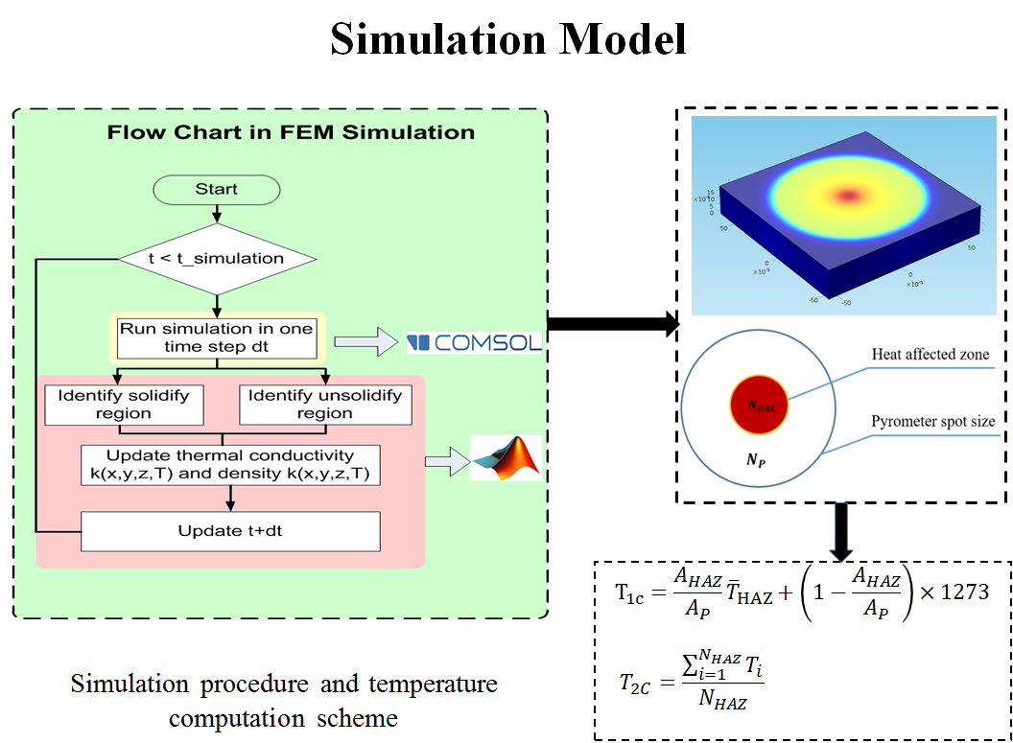
Temperature Measurement for SLM

Slide 13
What We’ve done (Temperature Measurement for SLM)

Slide 14
Research Results
Awards:
Second Prize in Chinese Engineering Competition, 2016.
Silver Medal in Spintech (旭泰科技論文獎) Thesis Awards, 2017.
Fellow (會士), Society for Experimental Mechanics (SEM), 美國實驗力學學會, 2018.
Paper publications:
Hong-Chuong Tran, Yu-Lung Lo, and Min-Hao Huang, "Analysis of Scattering and Absorption Characteristics of Metal Powder Layer for Selective Laser Sintering,“ Published in IEEE/ASME Transactions on Mechatronics (2017) (Ranking 1/44 in manufacturing field, Impact factor: 4.357)
Hong-Chuong Tran and Yu-Lung Lo, “Heat Transfer Simulation of Selective Laser Melting Based on Volumetric Heat Source with Powder Size Consideration," Published in the Journal of Material Processing Technology (2018) (Ranking 8/44 in manufacturing field, Impact factor: 3.147)
Patents: 3 Taiwan and 2 American Patents related to Laser Scanner/Simulation in Raining Model/Pyrometer for Melt Pool
Keynote Speaker, ICEM 2107 in Indonesia/ ICMMT 2018 in Russia.

Slide 15
Acknowledgment
We would like to thank for the research funding from

